Slide 1
From Structural Connectivity to Functional Connectivity: A phenomenological Whole Brain Model
Anirban Bandyopadhyay, Sayan Ghosh,
Neuroimage Team
Under Prof. V. Srinivasa Chakravarthy
IIT Madras

Slide 2
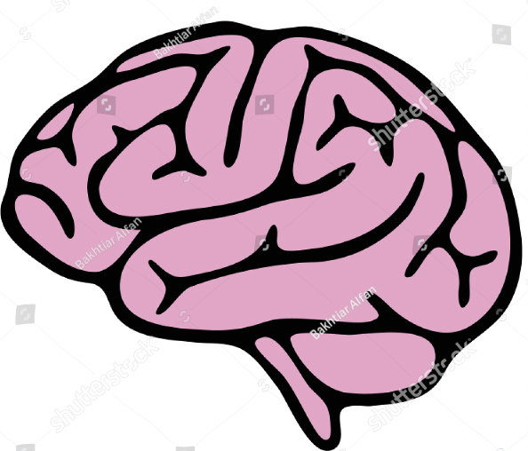
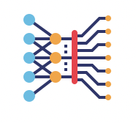
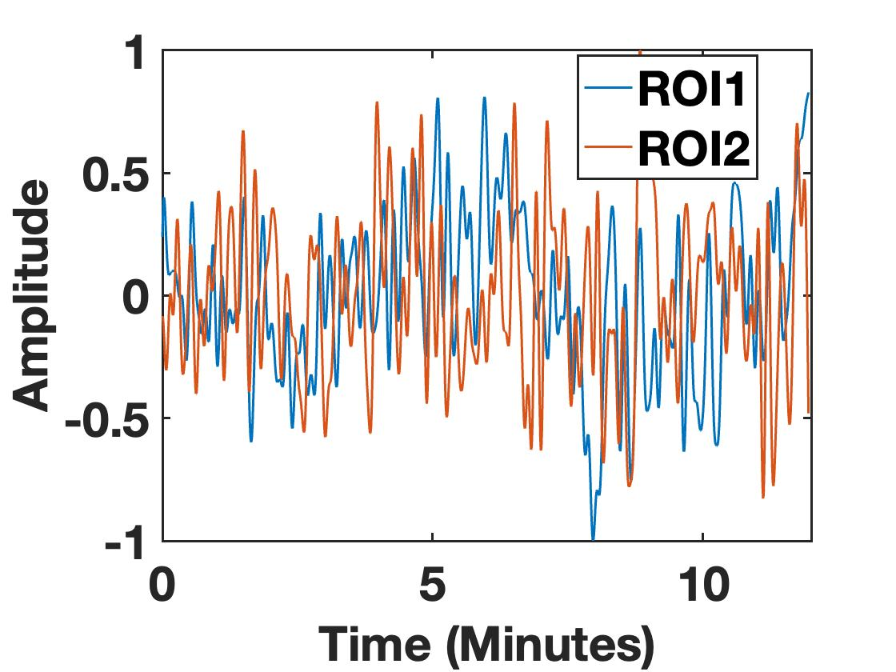
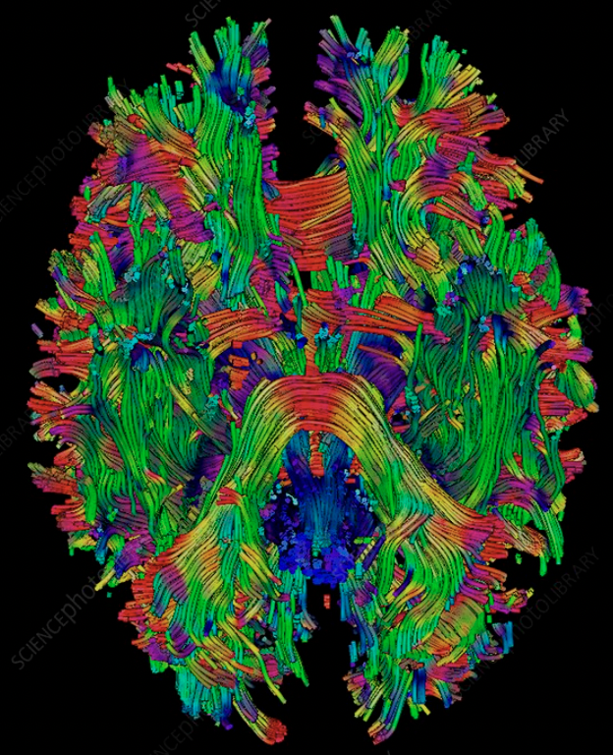

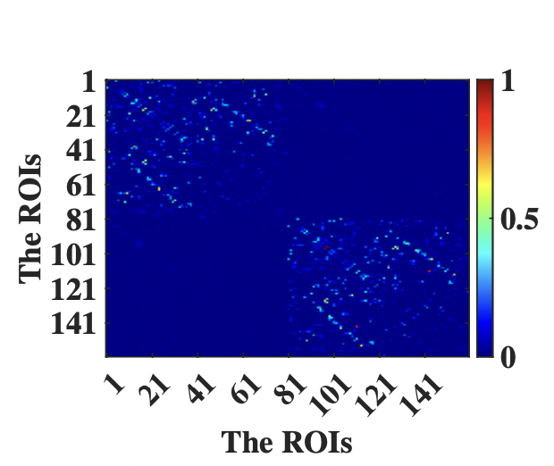
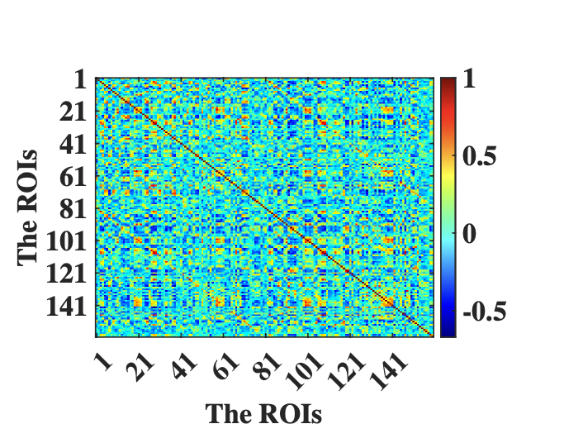
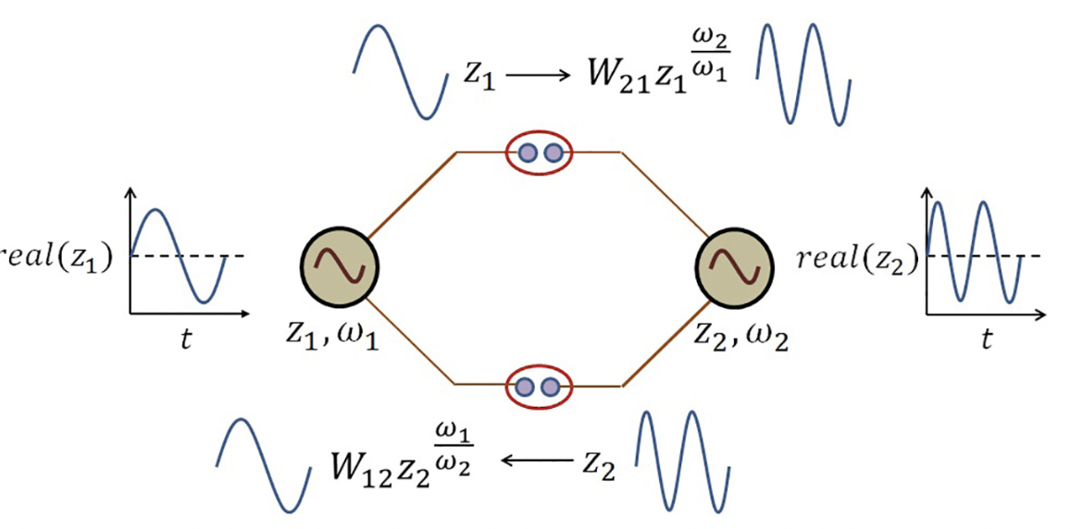
DTI
Tractography
Optimization
Correlation Coefficient
Power
Coupling
Structural Connectivity
Functional
Connectivity

Slide 3
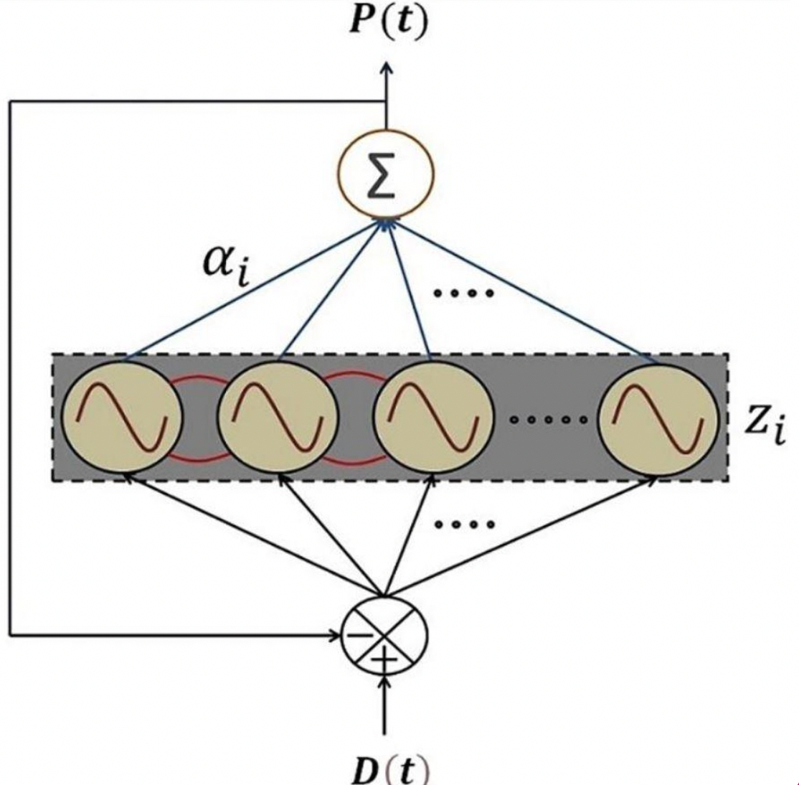
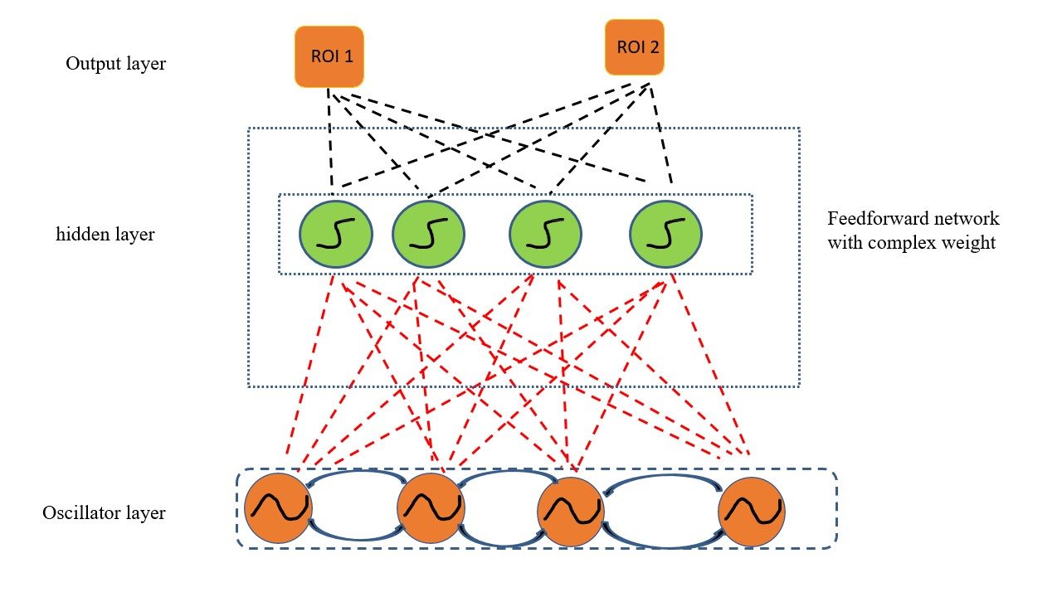
Basic Model Architecture:
second stage of learning
First stage of learning

Slide 4
Normalized Structural Connectivity

Slide 5
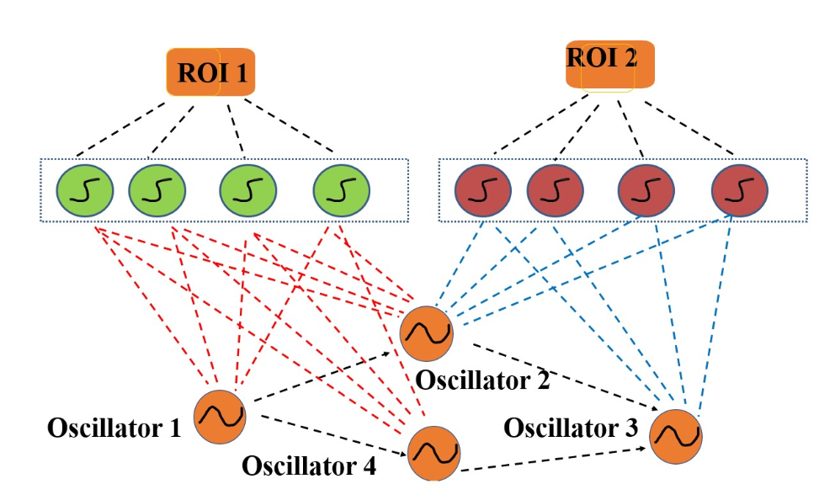
Main Model Architecture: Structural Connectivity based BOLD signal Learning Model

Slide 6
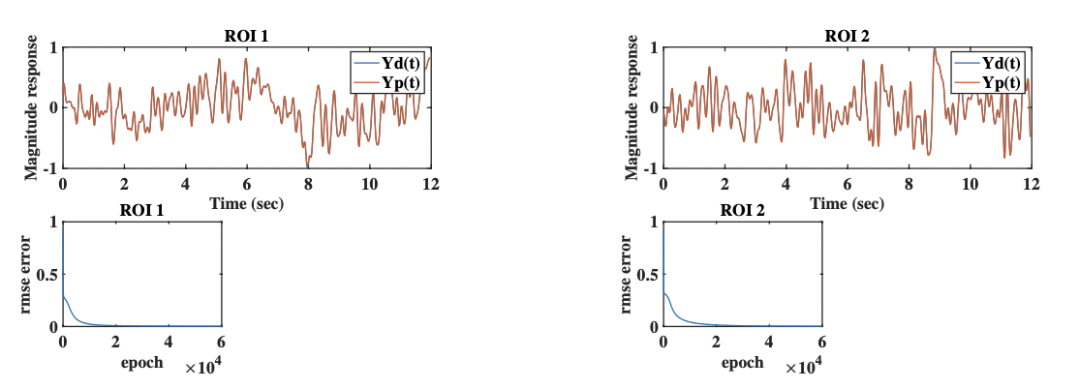
Simulated result for ROI 1 and ROI 2

Slide 7
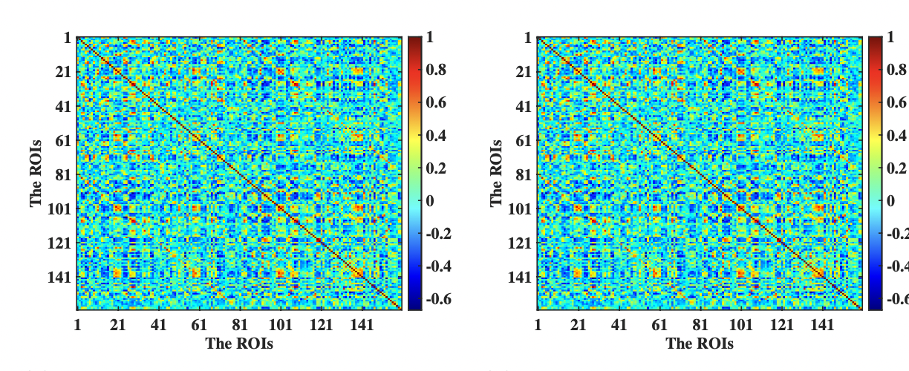
Functional Connectivity Comparison
Simulated
empirical

Slide 8
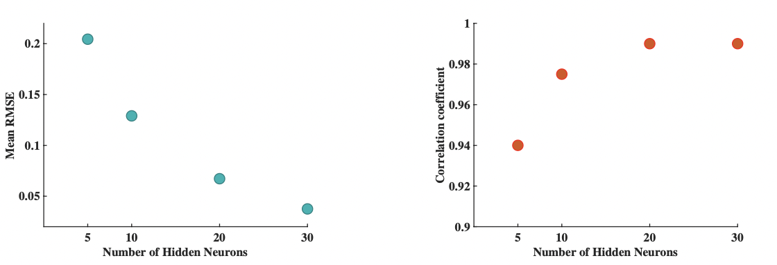
Network Characteristics :- Mean RMSE , and Correlation coefficient vs Number of hidden neuron

Slide 9
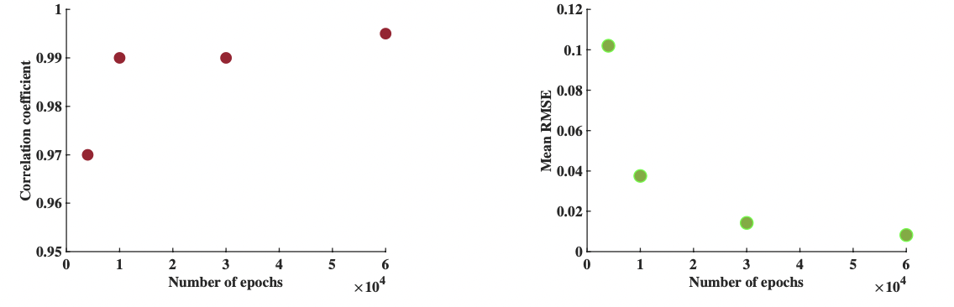
Network Characteristics :- Mean RMSE , and Correlation coefficient vs Number of epochs

Slide 10
Functional Connectivity Dynamics Analysis : Sliding Window Procedure
Define the window size and slide length : 120 TR (83.60 seconds); 2TR (1.44 seconds)
Calculate the functional connectivity matrix for each window.
Toal 538 numbers of window found.
Used k-means clustering with 4 states. (MATLAB K-Means)
States are the centroid for clusters.
Sorting the states with respect to the number of elements in the cluster.
Arrange them in ascending order.
Keep them in a single matrix (concatenate) and compare with the simulated data.
Repeat the process for simulated, and empirical one.
Ref: A Comparison of Static and Dynamic Functional Connectivities for Identifying Subjects and Biological Sex Using Intrinsic Individual Brain Connectivity, Sreevanson menon, and K. Krishnamurthy
Tracking Whole-Brain Connectivity Dynamics in the Resting State ; allen, Damraju et al; c)Towards a statistical test for functional connectivity dynamic, zalesky and brakespare

Slide 11
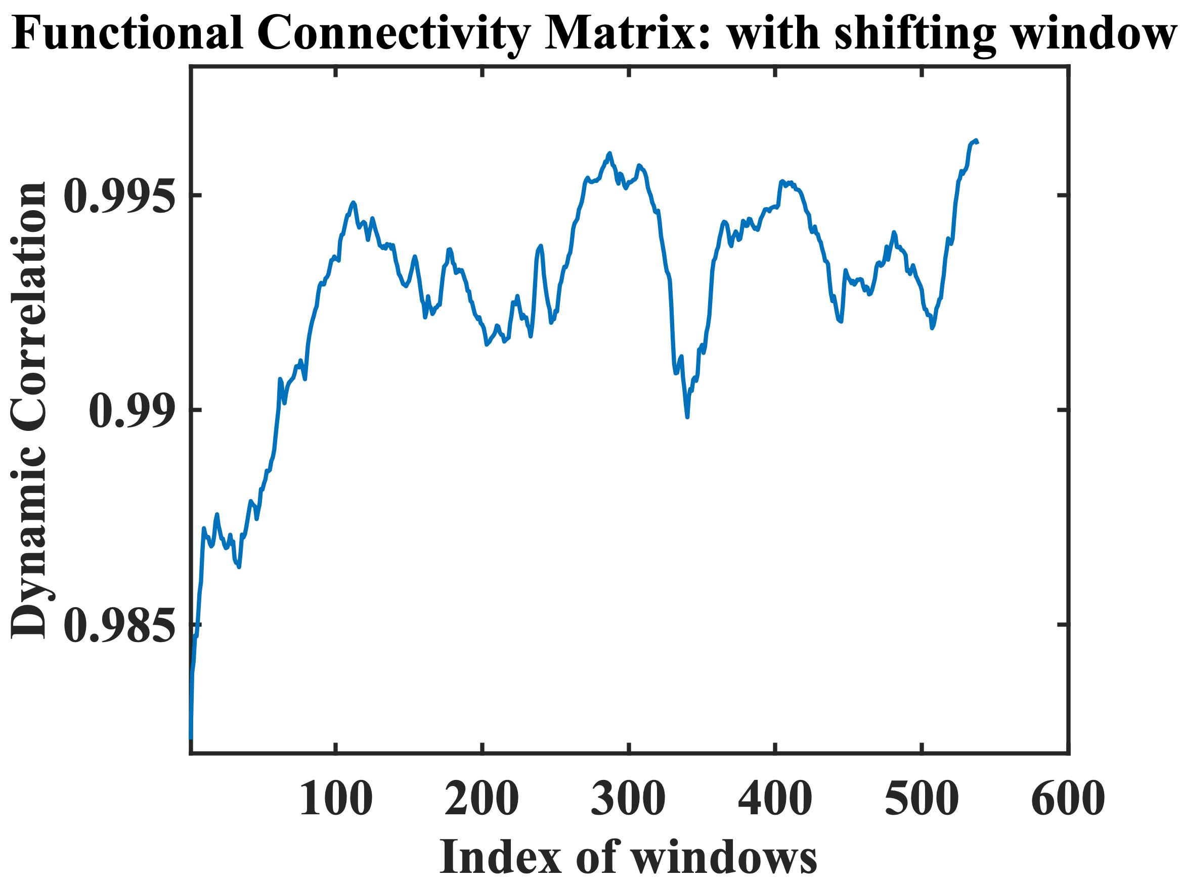
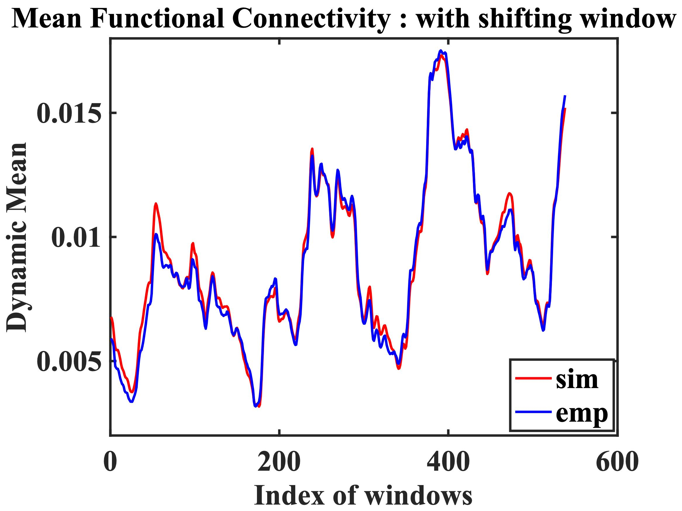
Result:-

Slide 12
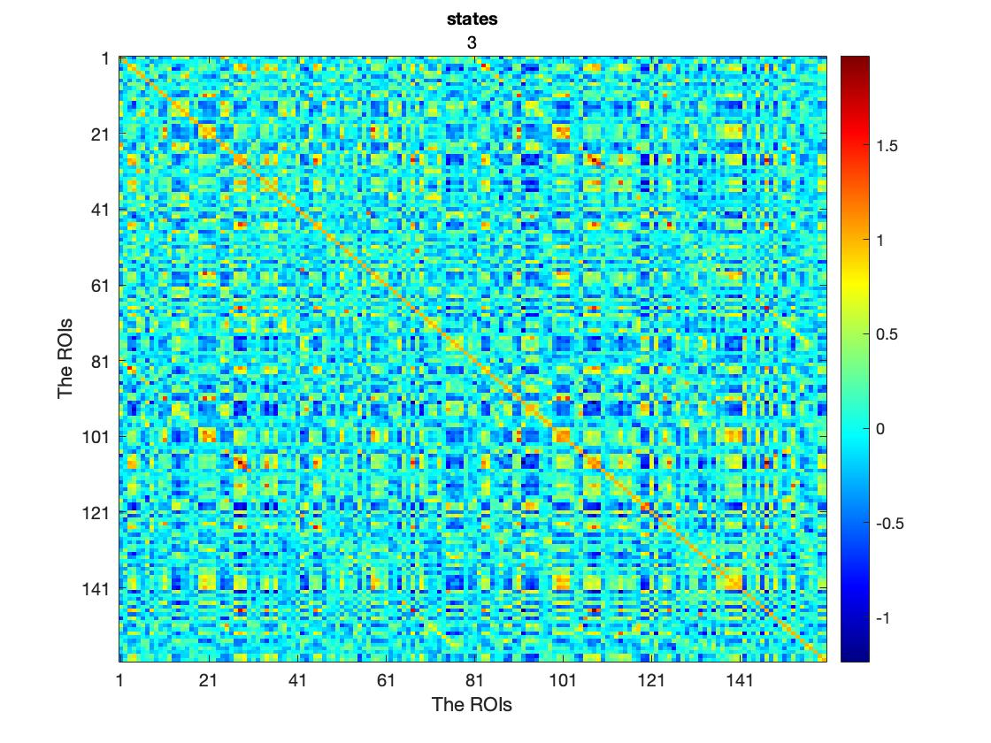
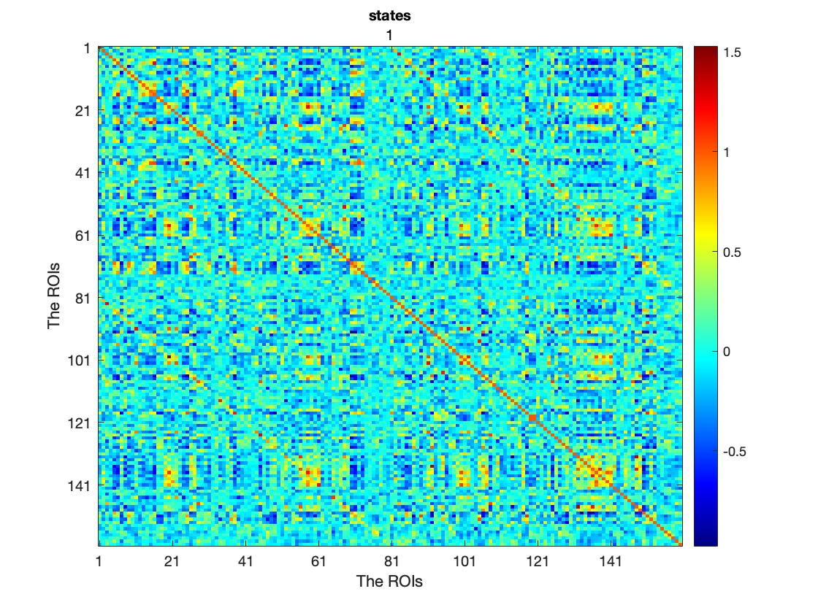
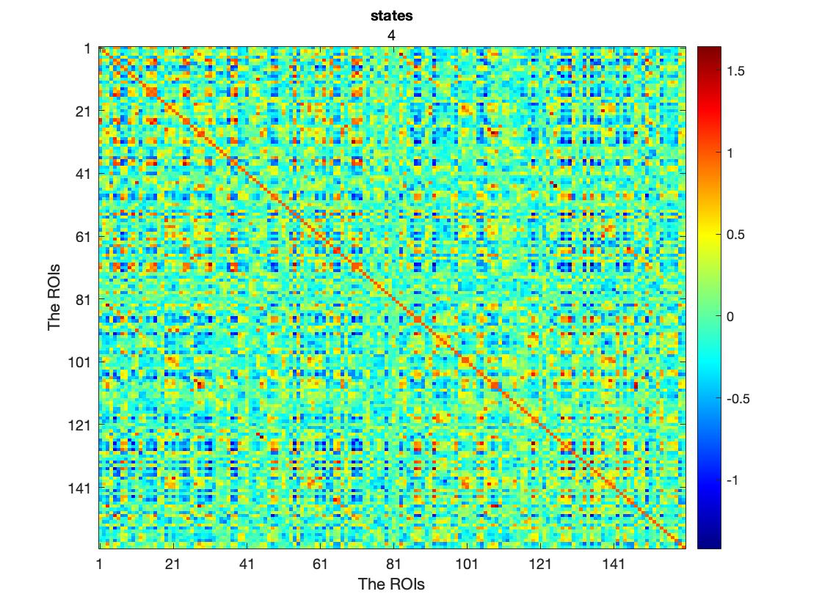
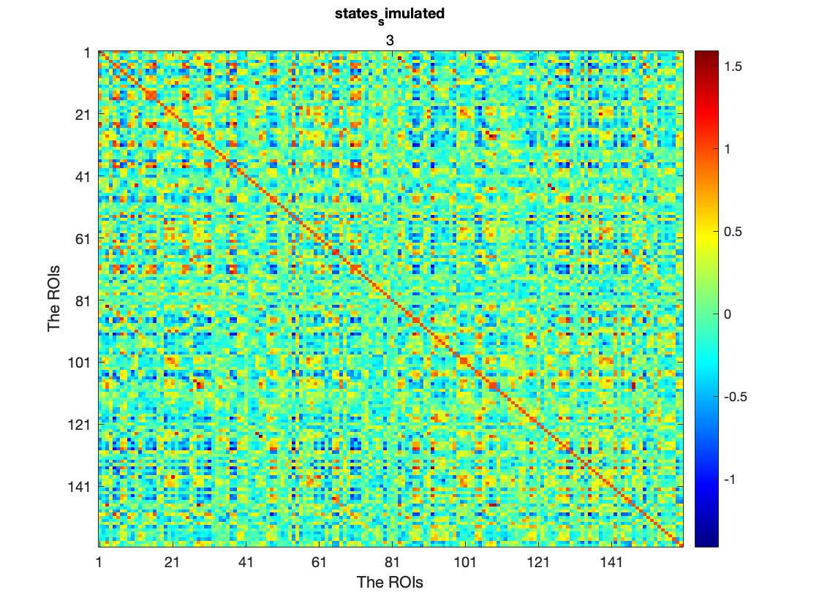
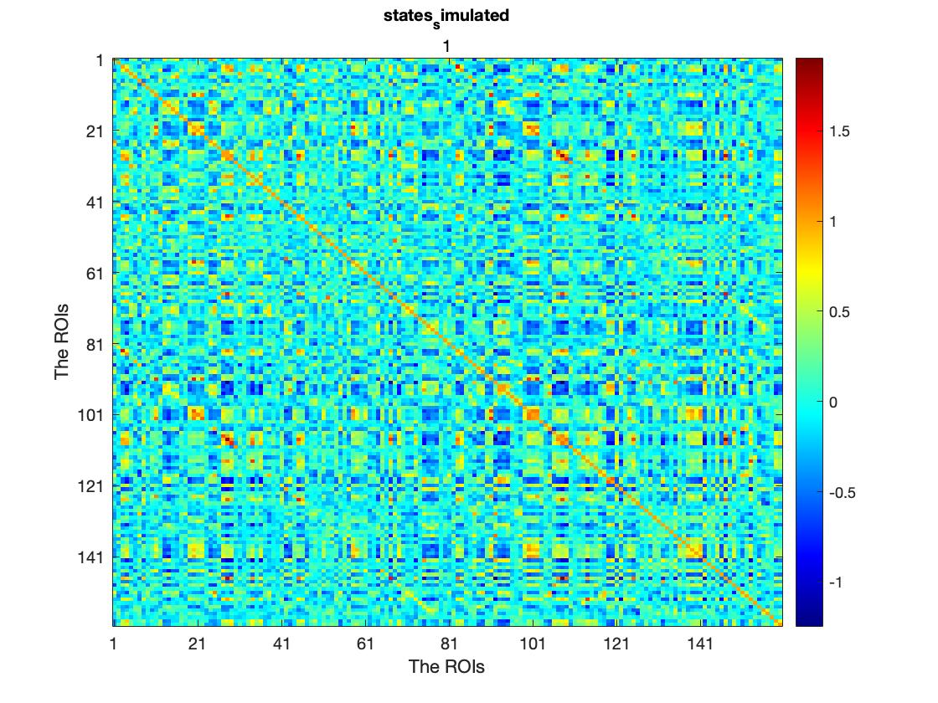
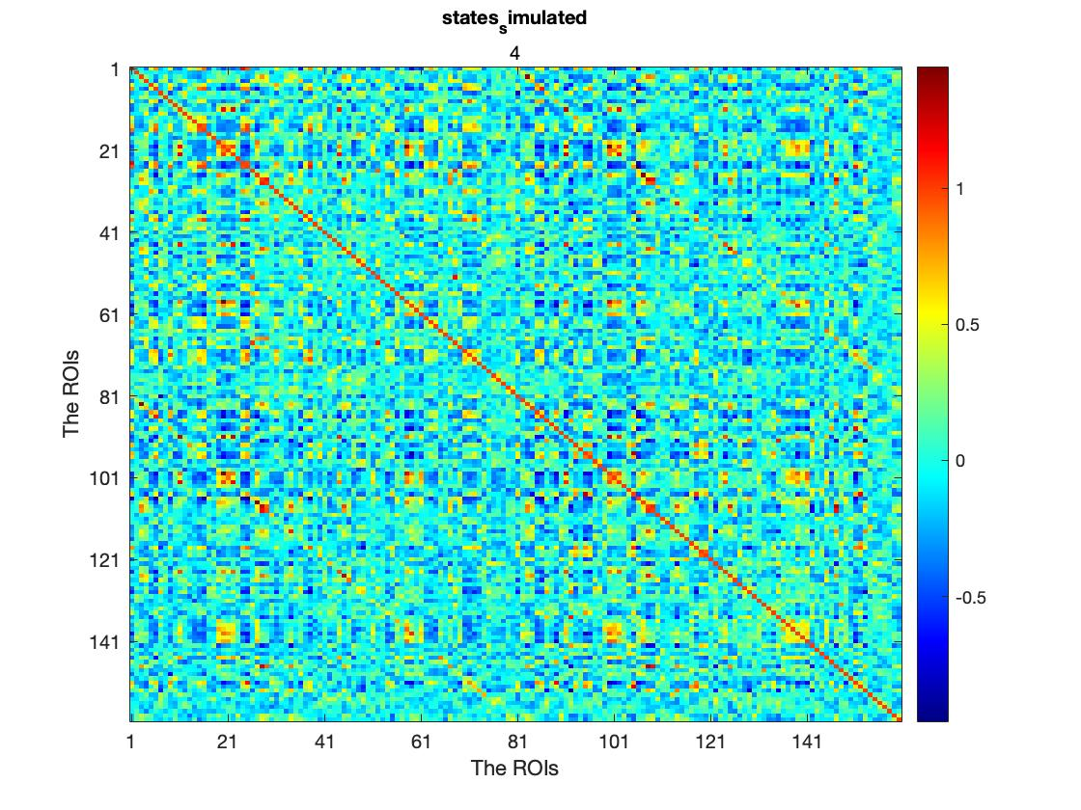
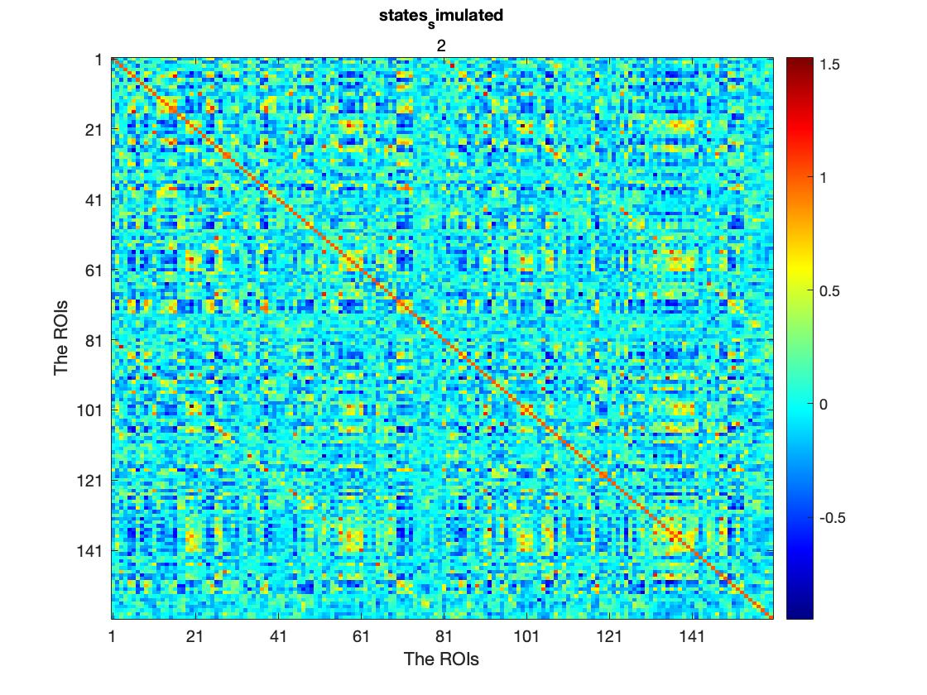
States after sorting (sorting according to number of elements in each cluster : empirical
Sorted states 1
Sorted states 2
Sorted states 3
Sorted states 4
simulated
Sorted states 1
Sorted states 2
Sorted states 3
Sorted states 4

Slide 13
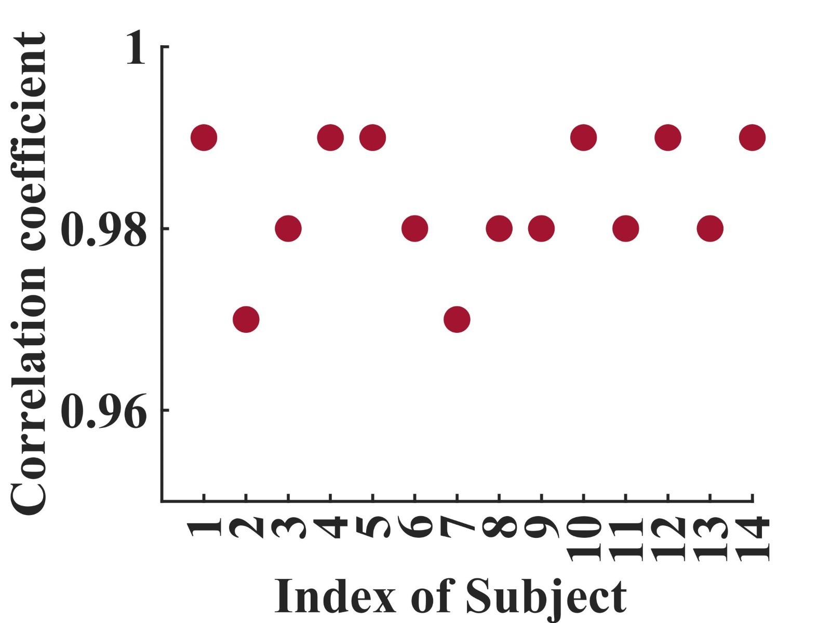
After performing taking all the four states, the comparison between simulated, and empirical .
Correlation coefficient : 0.9958
Functional Connectivity based Correlation value for 14 subjects

Slide 14
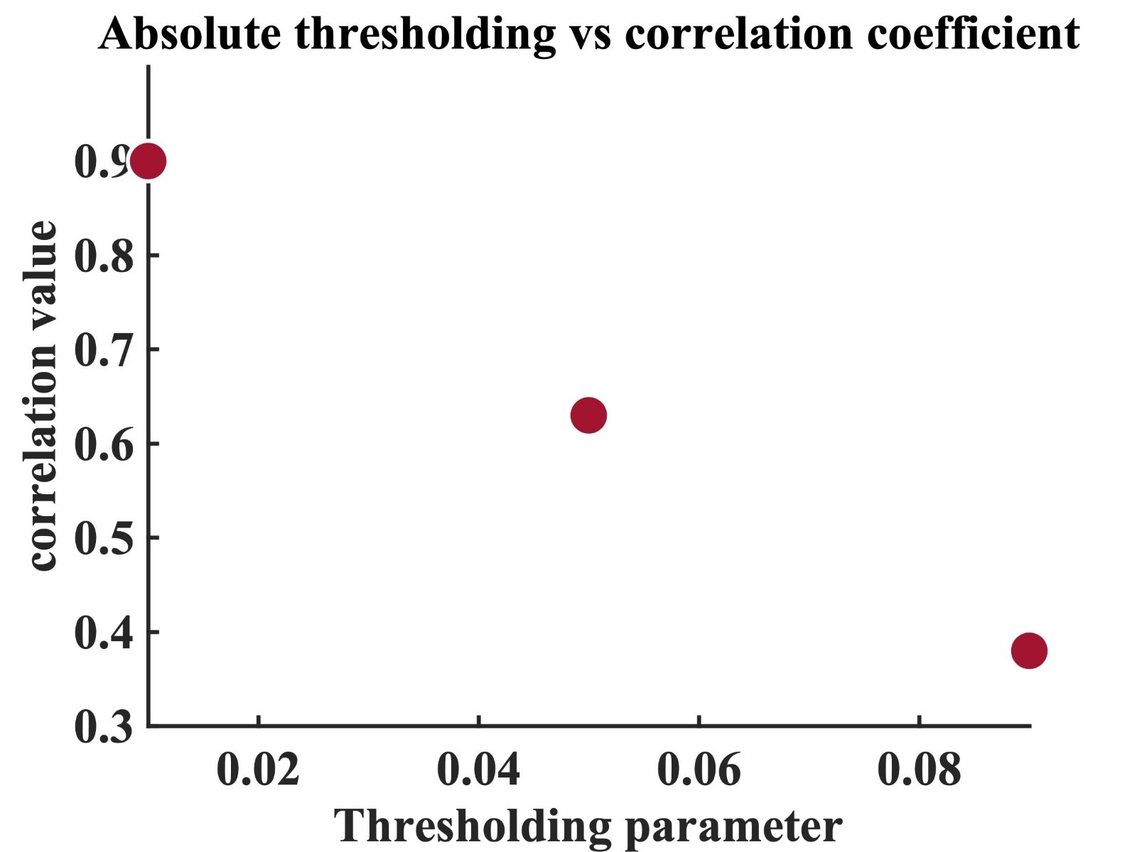
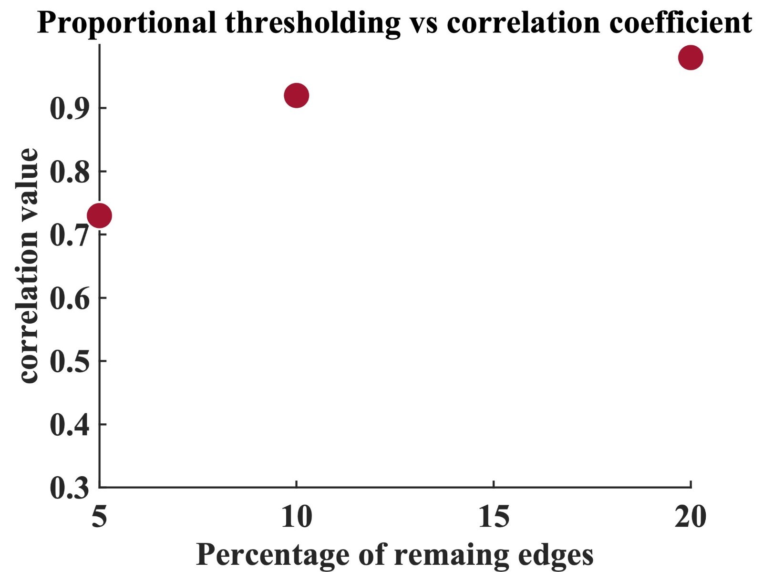
Loss of information : thresholding the structural connectivity matrix to visualize the effect of it on functional connectivity- implies the model can store the loss of information in terms of structural connectivity
(a) Correlation value after pruning the (b) Correlation value after retain a proportional amount of connectivity
Structural connectivity

Slide 15
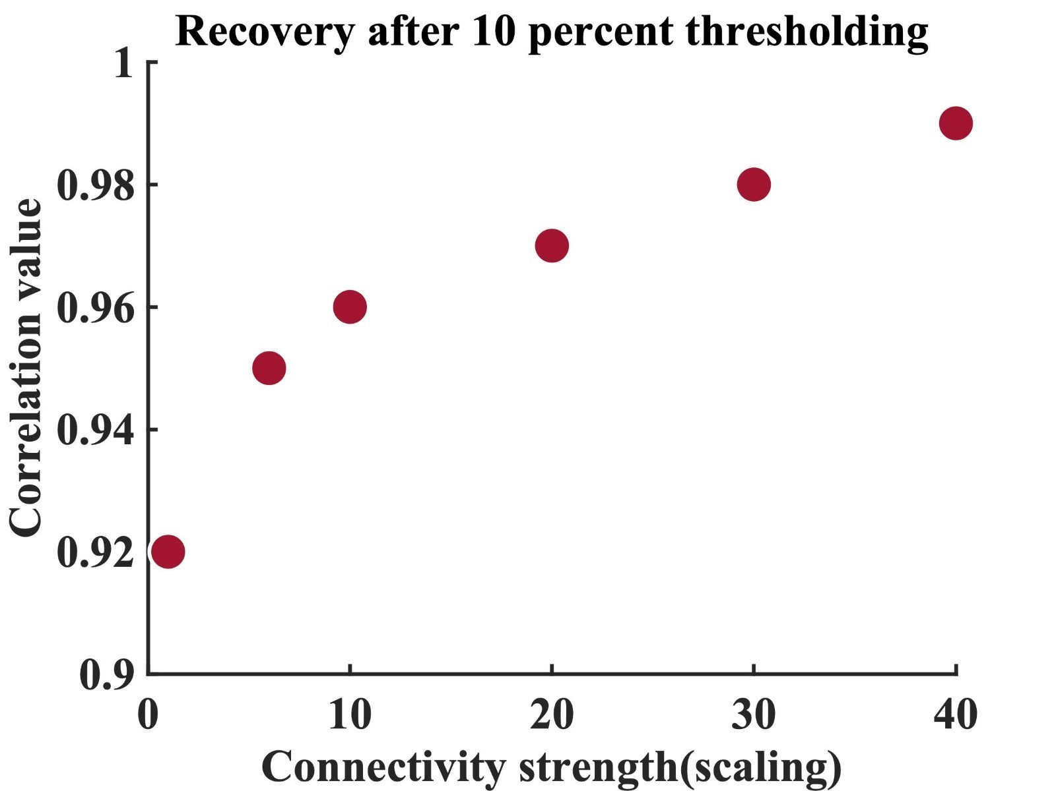
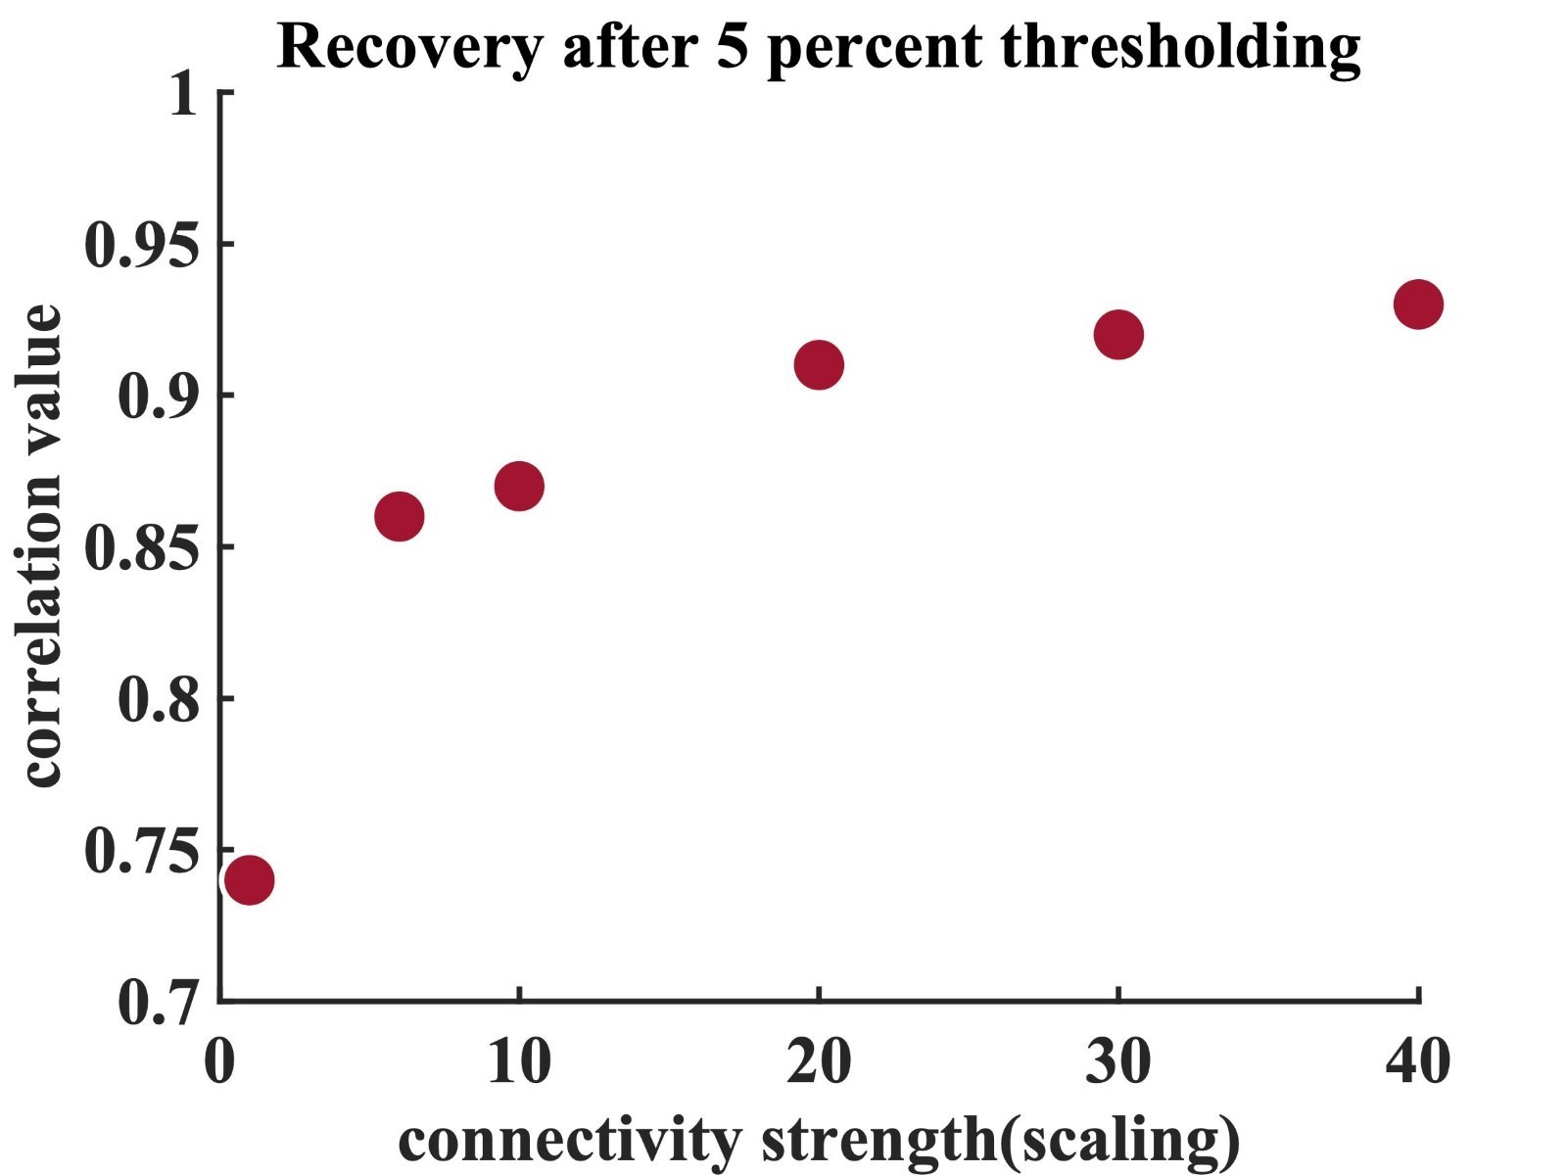
Restoring the Correlation Coefficient:- Scaling the structural connectivity (increasing the global coupling factor), can rehabilitate the correlation coefficient obtained from the simulation prior to pruning.
10 percentile Remaining SC
5 percentile remaining SC

Slide 16
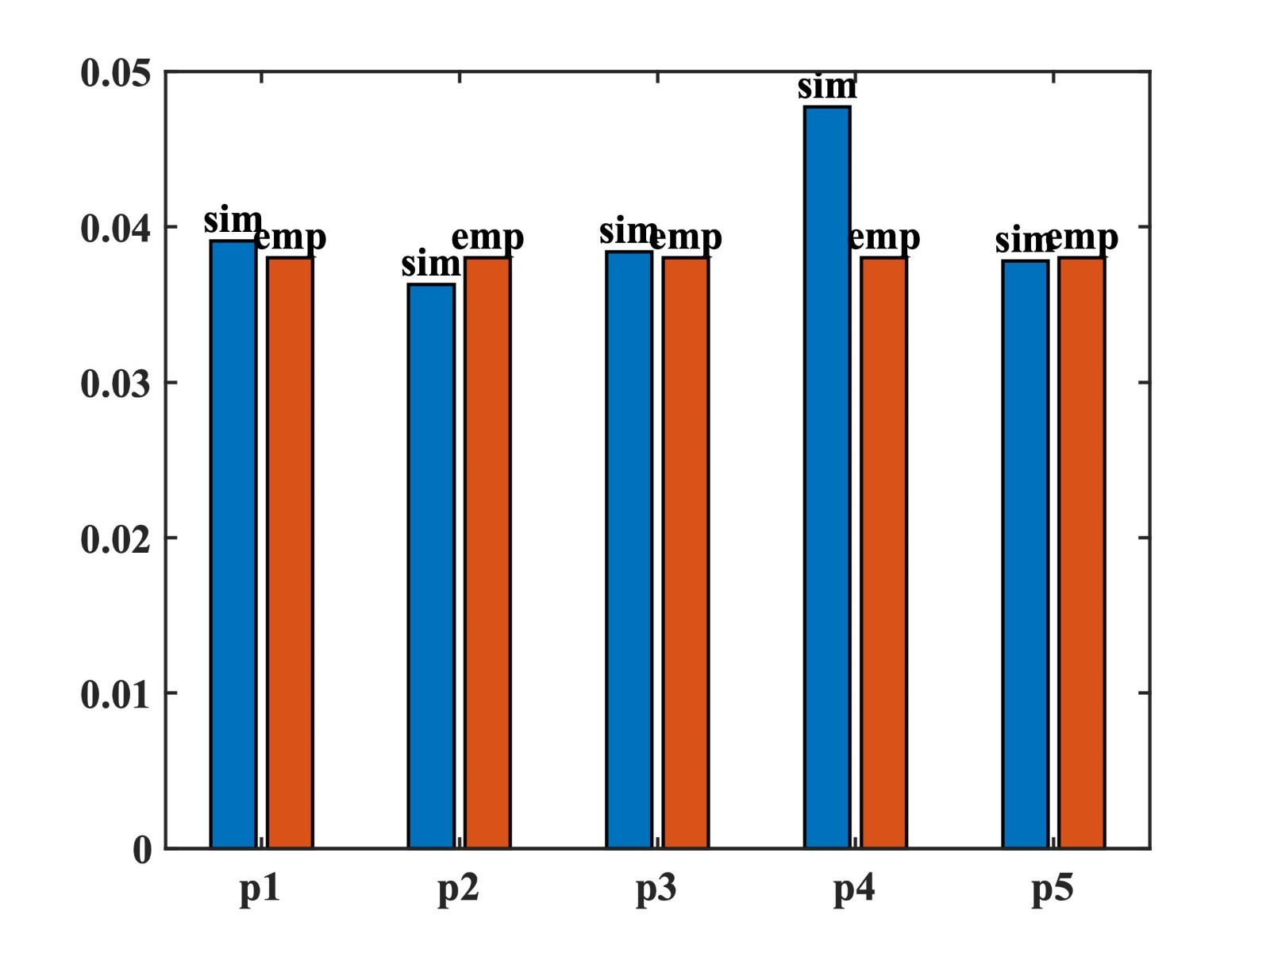
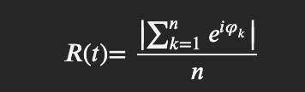
Metastability:-
“metastability as a measure of how variable are the states of phase configurations as a function of time, i.e. how the synchronization between the different nodes fluctuates across time’' . It can be measured as standard deviation of kuramoto ordered parameter given by the following equation (Deco et al)-
𝜑 represents instantaneous phase of BOLD signal at specific time t.
The methodology of doing this is to derive analytical signal with Hilbert transform, which provides the phases across time.

Slide 17
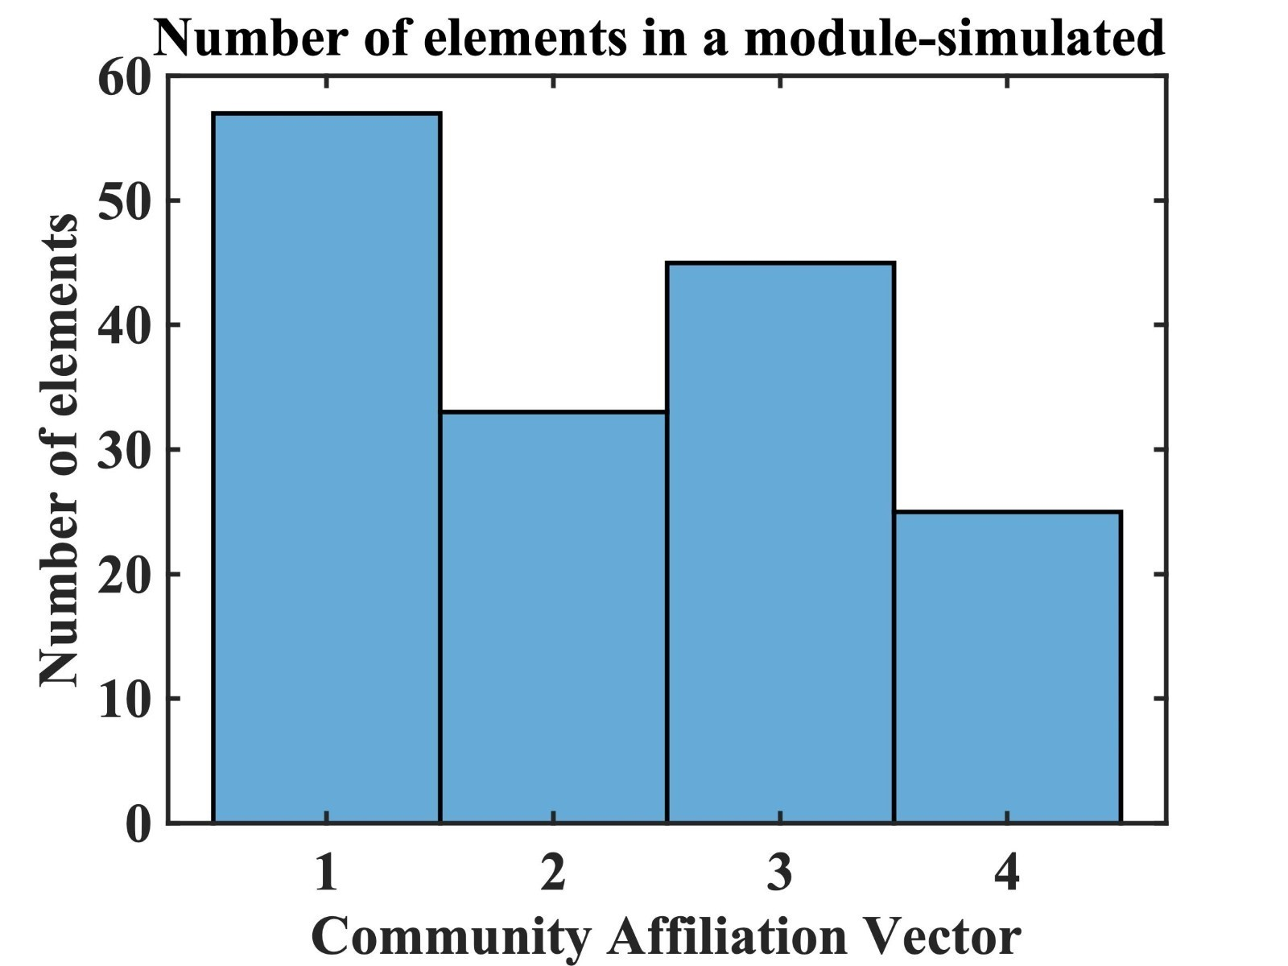
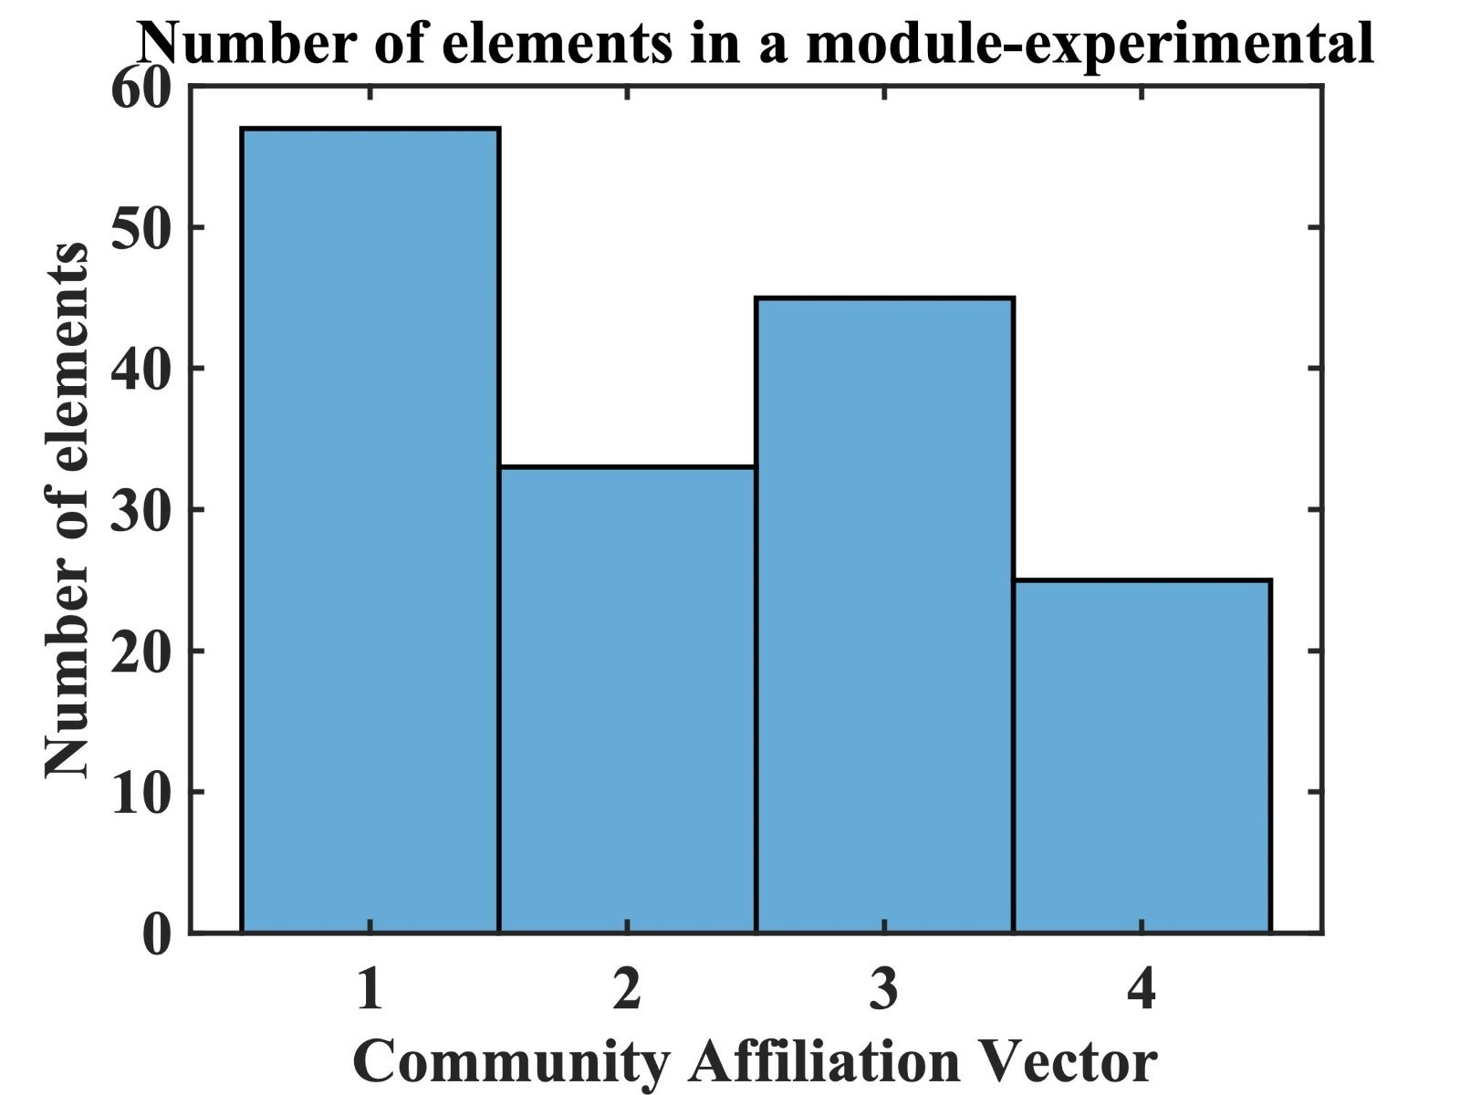
Default Mode Network (DMN) or Dynamic Core:-
Default mode network is the set of “rich-club” brain network with high clustering. The biological importance is that this region is more active and dynamic in the relaxed state, but activity diminished in the active state or task-specific case.
Result:-
Most component of the DMN resides in a certain community for both simulated, and empirical one.
It has been found that some important regions of DMN are in this region like anterior cingulate cortex, posterior cingular cortex, superior frontal gyrus, angular gyrus, parahyppocampal regions, Precuneus , superior temporal gyrus, middle temporal gyrus, temporal pole, temporal inferior, amygdala, hippocampus.
Procedure:-
1. Deduce the brain graph adjacency matrix from the functional connectivity matrix (average of fourteen participants).[negative values are negated]
2. Community detection from the "Louvain Algorithm", an unsupervised learning technique
3. Calculate the modularity value.

Slide 18
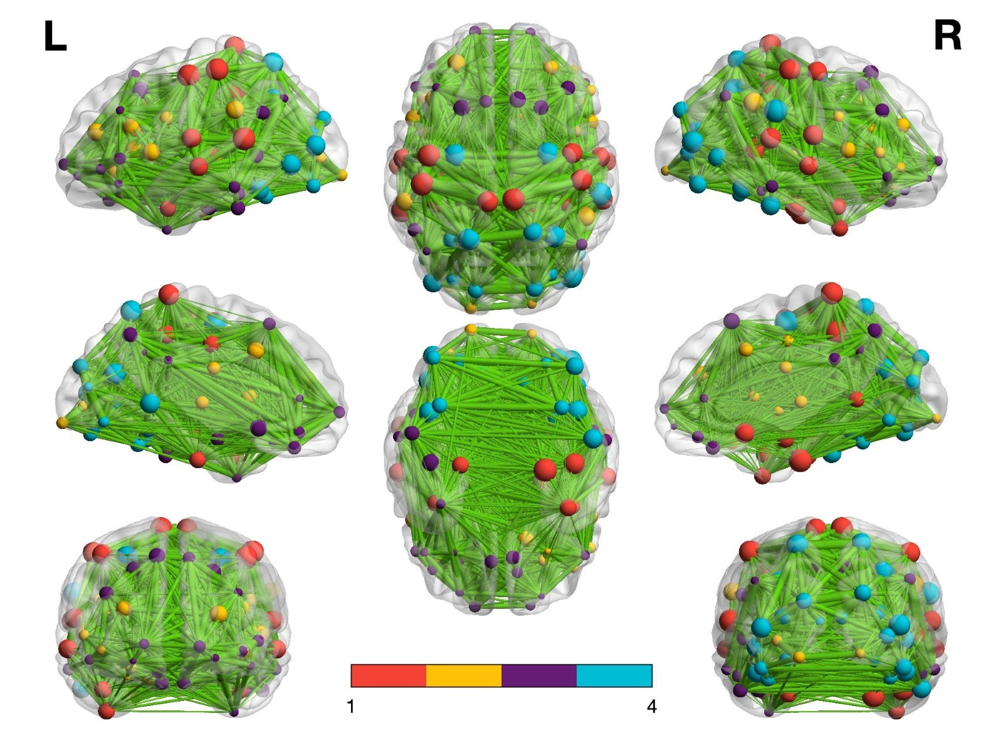
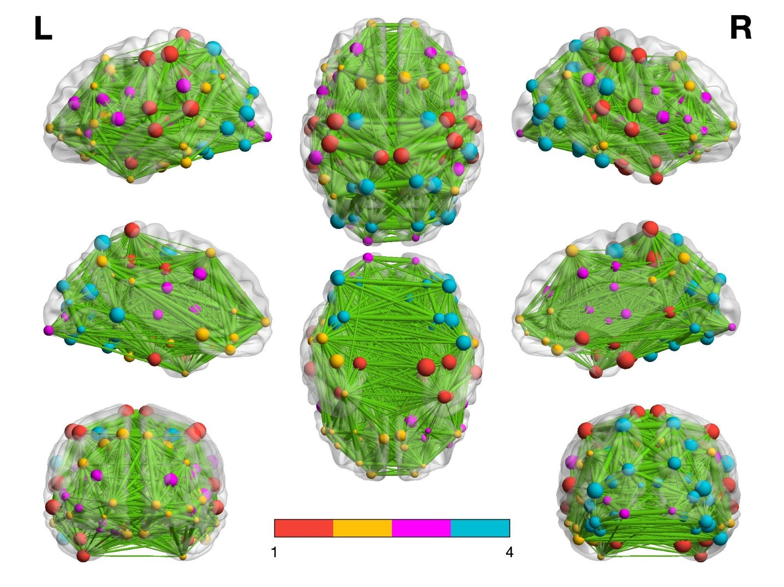
Pictorial representation for single participant (Brainnet viewer software)
The modularity value for experimental network is 0.33
The modularity value for simulated network is 0.34.
Due to initialization, community for DMN , community indexed 3 for simulated data reflected in the community 2 of the experimental data

Slide 19
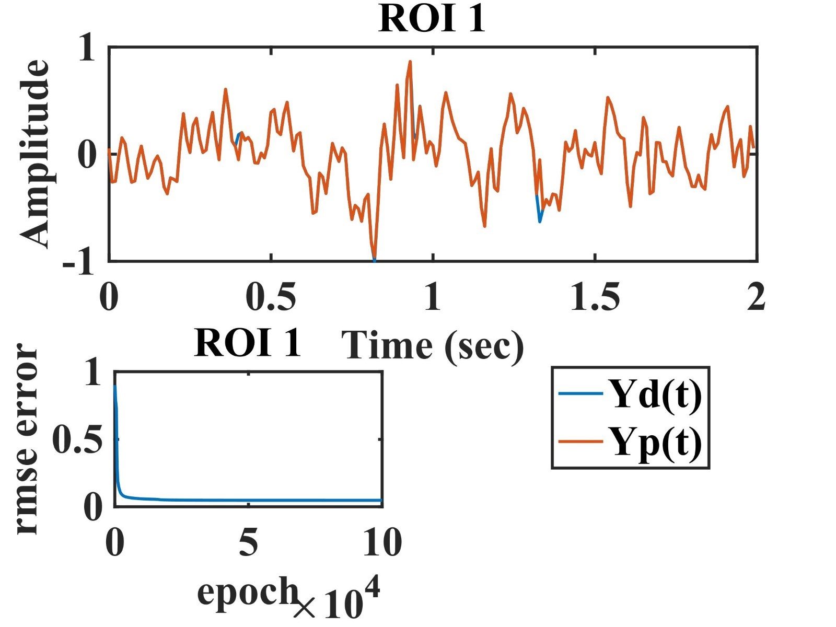
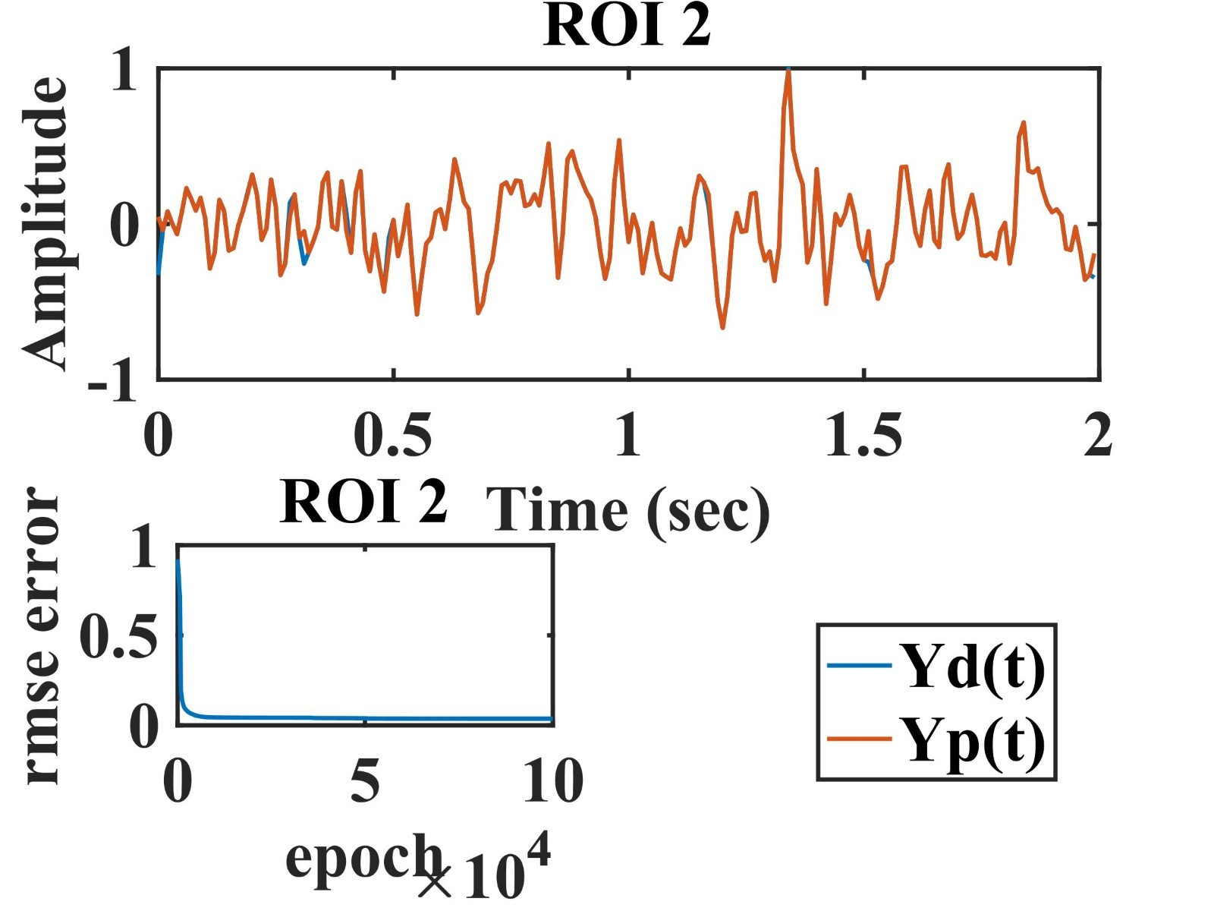
Time series data for Paris-dataset: simulated vs experimental

Slide 20
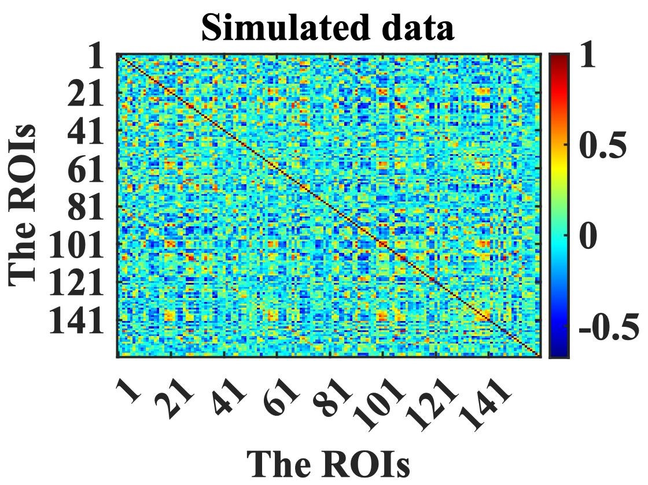
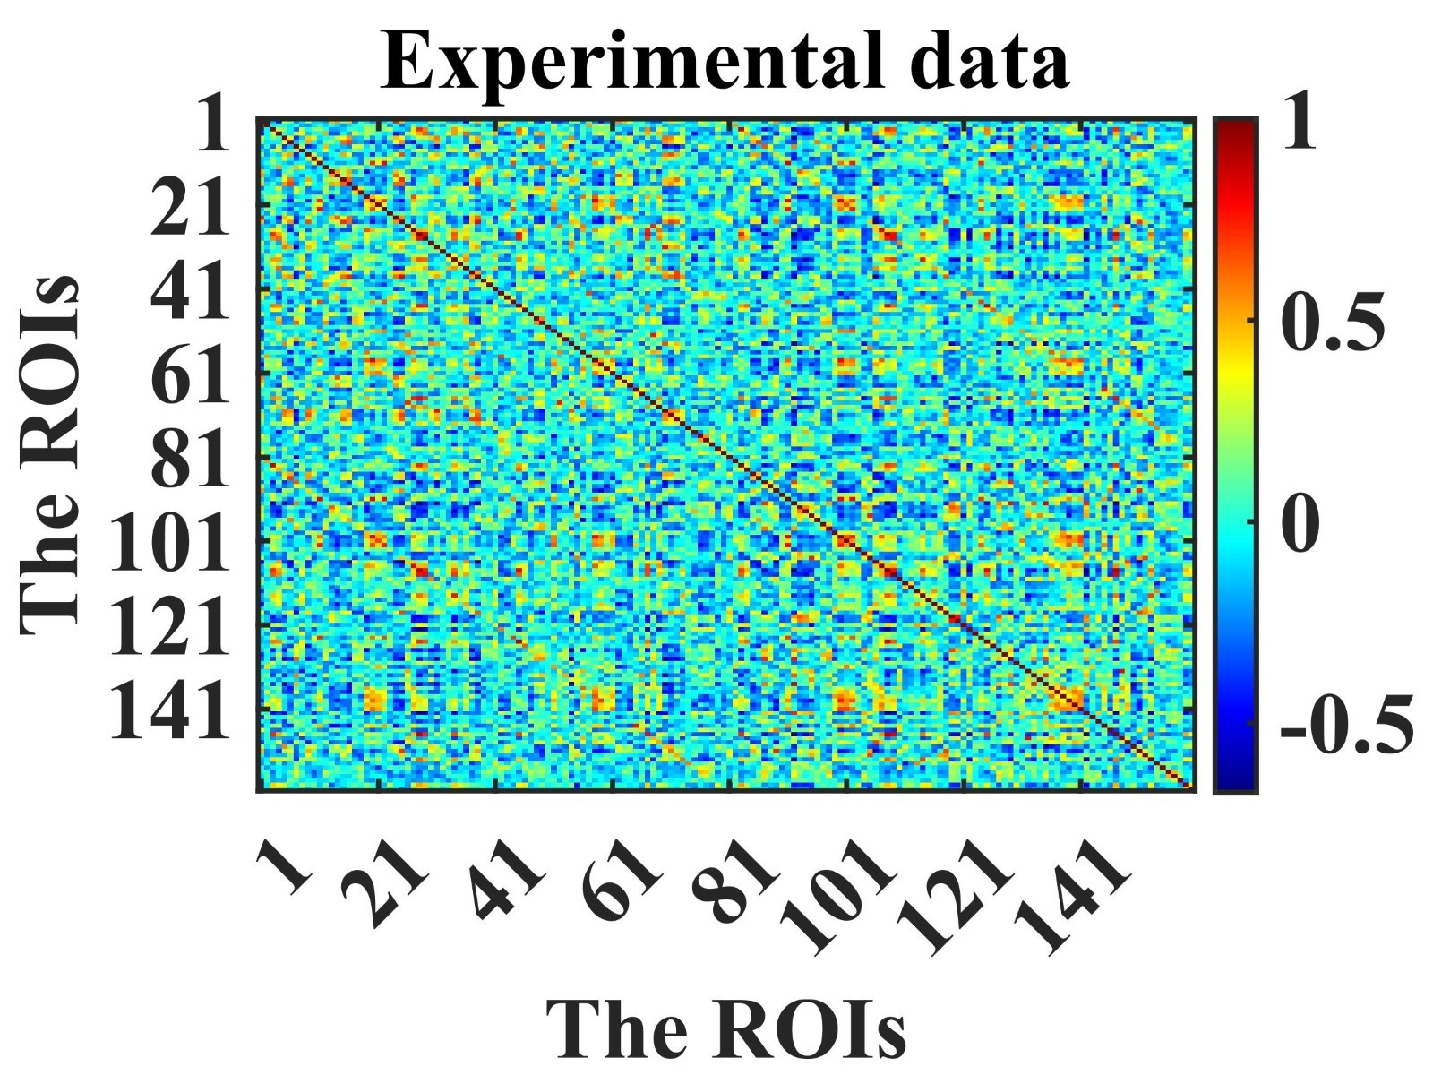
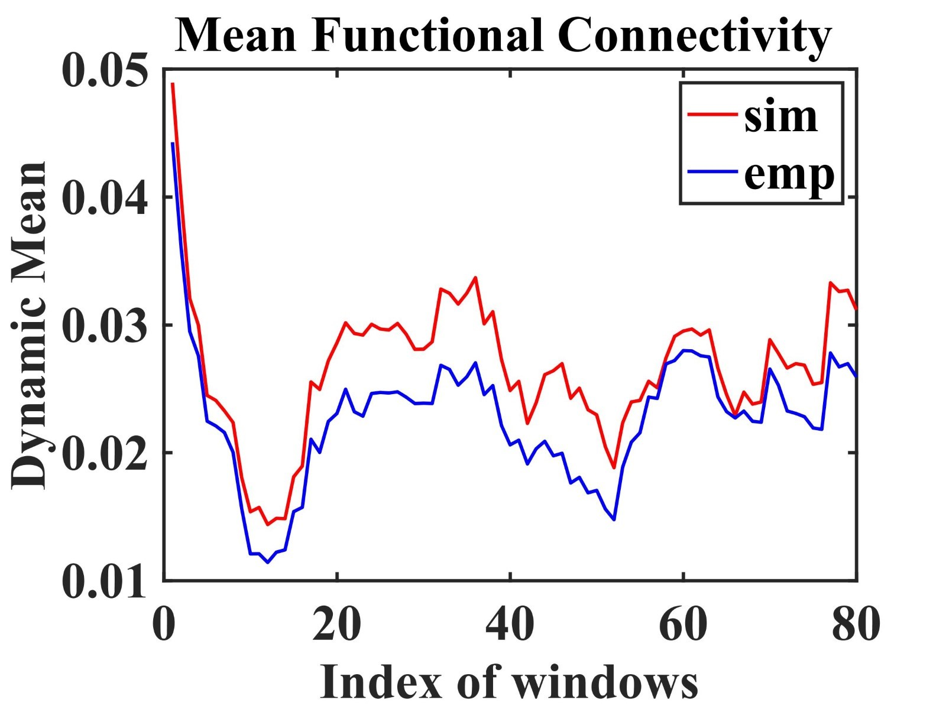
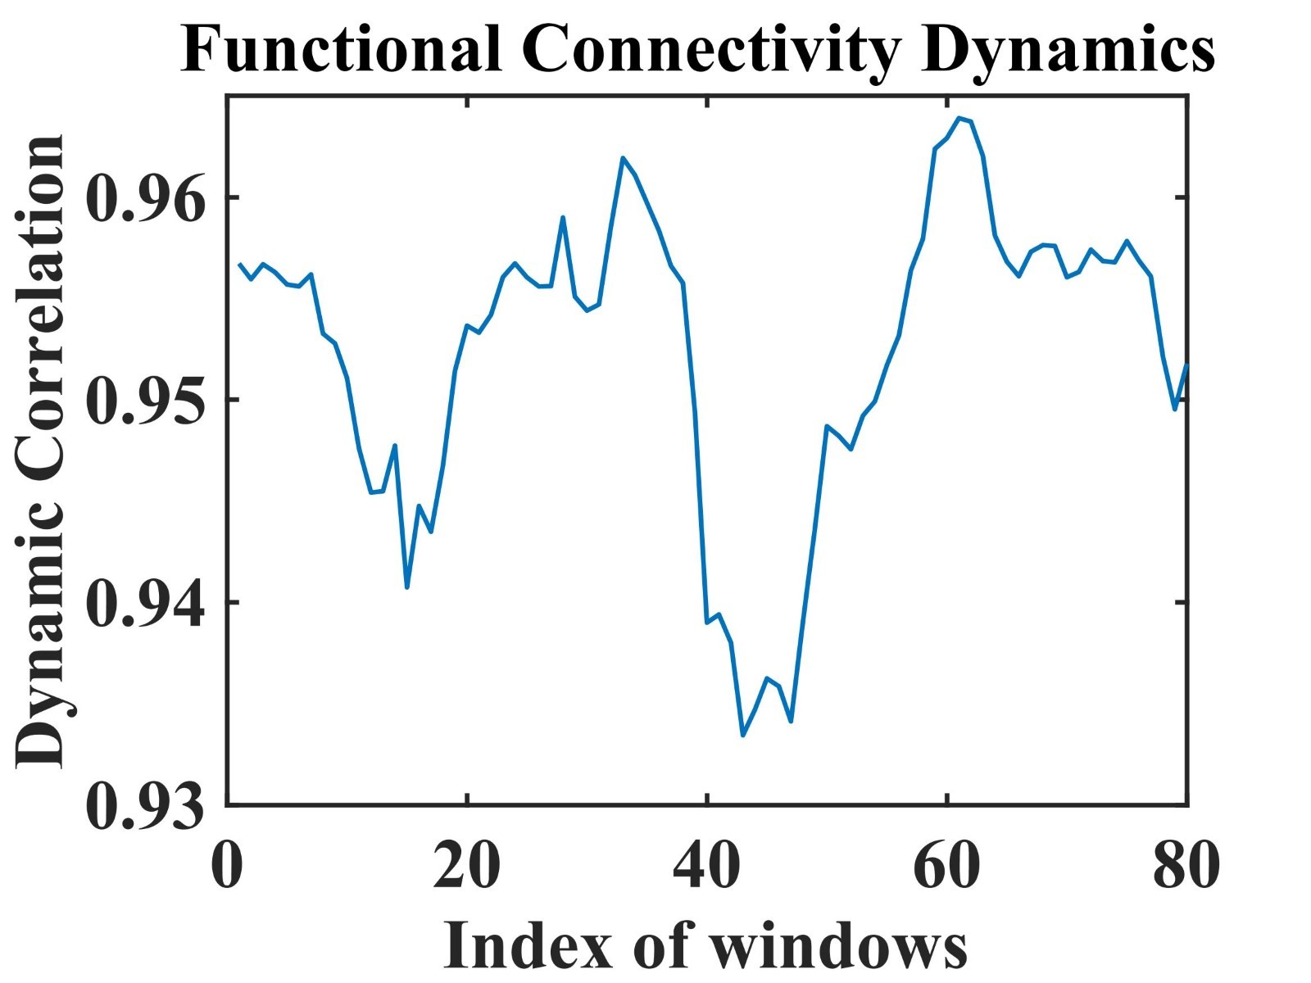
Functional Connectivity and Functional Connectivity Dynamics:- (paris-dataset)

Slide 21
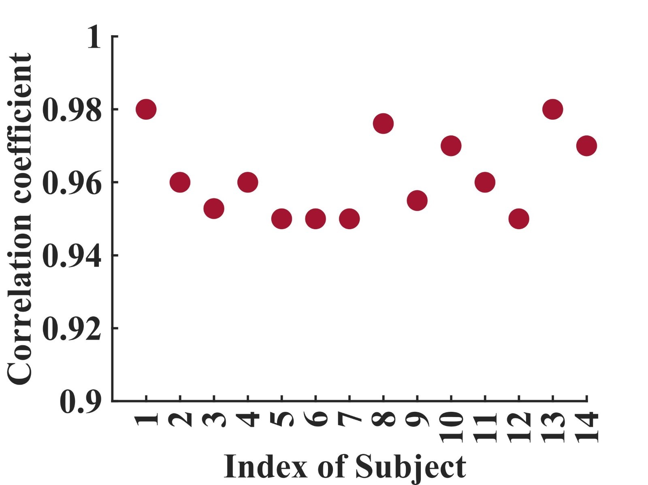
Correlation Coefficient for Paris Dataset

Slide 22
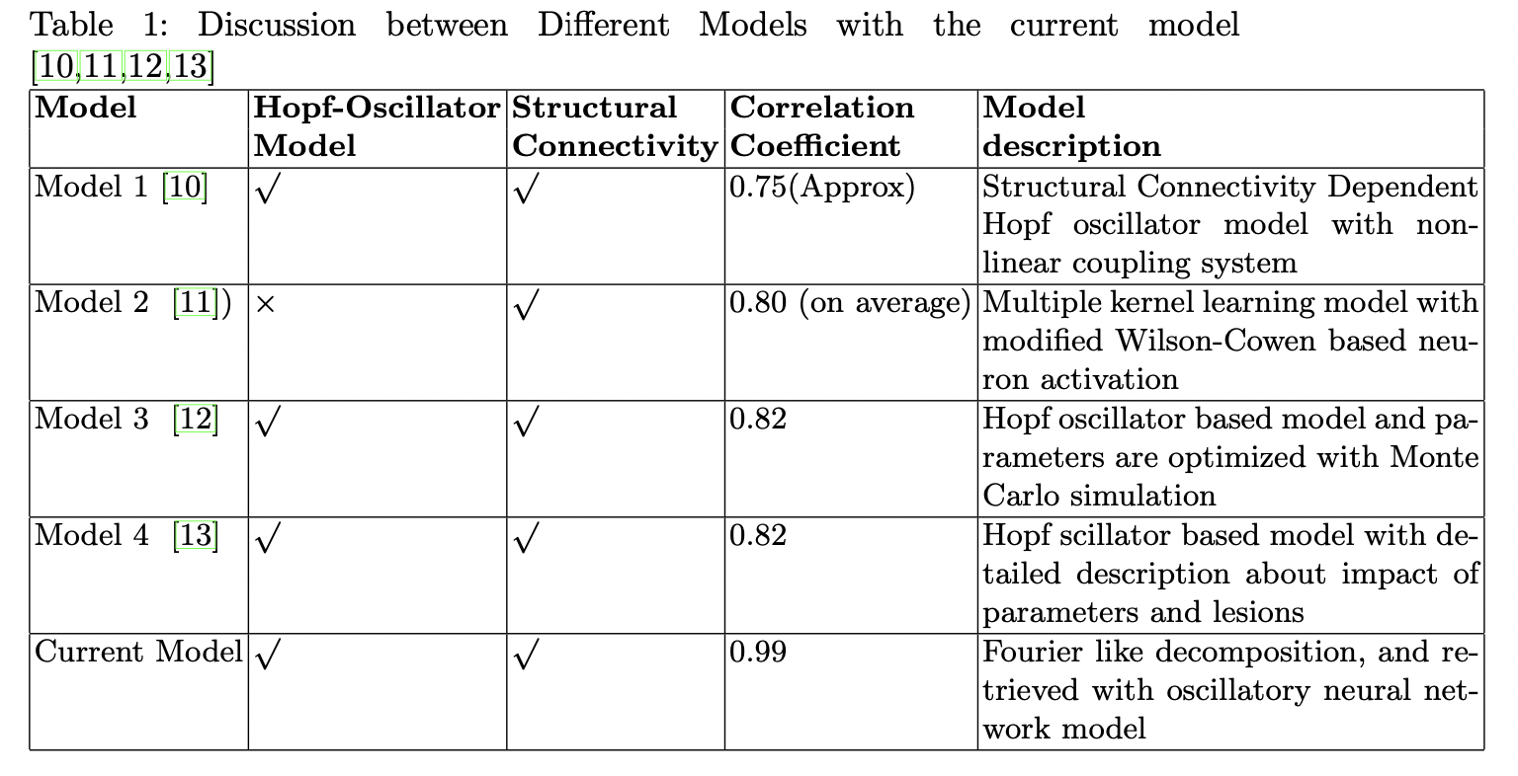

Slide 23
References:
10. Deco, G., Kringelbach, M.L., Jirsa, V.K. et al. The dynamics of resting fluctuations in the brain: metastability and its dynamical cortical core. Sci Rep 7, 3095 (2017).
11. Surampudi, Sriniwas Govinda, Shruti Naik, Raju Bapi Surampudi, Viktor K. Jirsa, Avinash Sharma, and Dipanjan Roy. ”Multiple kernel learning model for relating structural and functional connectivity in the brain.” Scientific reports 8, no. 1 (2018):
1-14. 12. Iravani, Behzad, Artin Arshamian, Peter Fransson, and Neda Kaboodvand.
”Whole-brain modelling of resting state fMRI differentiates ADHD subtypes and
facilitates stratified neuro-stimulation therapy.” NeuroImage 231 (2021): 117844.
13. Hahn, Gerald, Gorka Zamora-Lo ́pez, Lynn Uhrig, Enzo Tagliazucchi, Helmut Laufs, Dante Mantini, Morten L. Kringelbach, Bechir Jarraya, and Gustavo Deco. ”Signature of consciousness in brain-wide synchronization patterns of monkey and
human fMRI signals.” NeuroImage 226 (2021): 117470.

Slide 24
DATA Collection;
The data can be found here - https://figshare.com/articles/dataset/ParisH CPbrainconnectivitydata/3749595]. Total 40 participants data with approx 55 minutes time points is taken with repetition time 0.72 seconds. In this study, we only take the 1st session data of 1196 time points of approx 15 minutes.

Slide 25
In Literature :
1. A trainable oscillatory neural network for modelling BOLD signals *A. BANDYOPADHYAY¹, S. GHOSH¹, D. BISWAS¹, B. S², S. V. CHAKRAVARTHY¹; 1Dept. of Biotech., IIT Madras, Chennai, India; ²IIIT Hyderabad, Hyderabad, India, Society For Neuroscience Conference . (Accepted).
2. A Phenomenological Deep Oscillatory Neural Network Model to Capture the Whole Brain Dynamics in terms of BOLD signal, *A. BANDYOPADHYAY1, S. GHOSH1, D. BISWAS1, B. S2, S. V. CHAKRAVARTHY1; 1Dept. of Biotech., IIT Madras, Chennai, India; 2IIIT Hyderabad, Hyderabad, India, ICONIP 2022 . (Accepted).

